Slide 1
Classification Problem
Concepts and Techniques
Source: Jiawei Han, Micheline Kamber, and Jian Pei
University of Illinois at Urbana-Champaign &
Simon Fraser University
©2011 Han, Kamber & Pei. All rights reserved.

Slide 2
Classification: Basic Concepts
Classification: Basic Concepts
Decision Tree Induction
Bayes Classification Methods
Rule-Based Classification
Model Evaluation and Selection
Techniques to Improve Classification Accuracy: Ensemble Methods
Summary

Slide 3
Prediction Problems: Classification vs. Numeric Prediction
Classification
  predicts categorical class labels (discrete or nominal)
  classifies data (constructs a model) based on the training set and the values (class labels) in a classifying attribute and uses it in classifying new data
Numeric Prediction
  models continuous-valued functions, i.e., predicts unknown or missing values
Typical applications
  Credit/loan approval:
  Medical diagnosis: if a tumor is cancerous or benign
  Fraud detection: if a transaction is fraudulent
  Web page categorization: which category it is

Slide 4

Decision Tree Induction: An Example
Training data set: Buys_computer
The data set follows an example of Quinlan’s ID3 (Playing Tennis)
Resulting tree:
age?
<=30
overcast
>40
31..40
student?
yes
credit rating?
no
yes
excellent
fair
no
yes
no
yes

Slide 5
Algorithm for Decision Tree Induction
Basic algorithm (a greedy algorithm)
  Tree is constructed in a top-down recursive divide-and-conquer manner
  At start, all the training examples are at the root
  Attributes are categorical (if continuous-valued, they are discretized in advance)
  Examples are partitioned recursively based on selected attributes
  Test attributes are selected on the basis of a heuristic or statistical measure (e.g., information gain)
Conditions for stopping partitioning
  All samples for a given node belong to the same class
  There are no remaining attributes for further partitioning – majority voting is employed for classifying the leaf
  There are no samples left

Slide 6
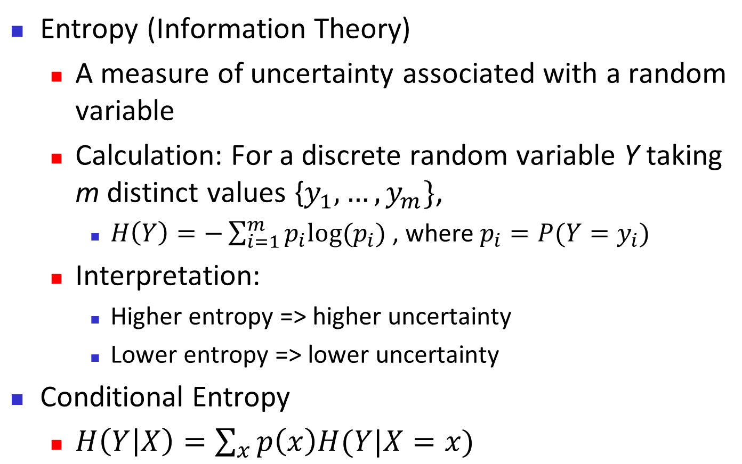

Brief Review of Entropy
m = 2

Slide 7



Attribute Selection Measure: Information Gain (ID3/C4.5)
Select the attribute with the highest information gain
Let p_{i} be the probability that an arbitrary tuple in D belongs to class C_{i}, estimated by |C_{i, D}|/|D|
Expected information (entropy) needed to classify a tuple in D:
Information needed (after using A to split D into v partitions) to classify D:
Information gained by branching on attribute A
Notes:
I : the expected information needed to classify a given sample
E (entropy) : expected information based on the partitioning into subsets by A

Slide 8






Attribute Selection: Information Gain
Class P: buys_computer = “yes”
Class N: buys_computer = “no”
means “age <=30” has 5 out of 14 samples, with 2 yes’es and 3 no’s. Hence
Similarly,

Slide 9
Computing Information-Gain for Continuous-Valued Attributes
Let attribute A be a continuous-valued attribute
Must determine the best split point for A
  Sort the value A in increasing order
  Typically, the midpoint between each pair of adjacent values is considered as a possible split point
    (a_{i}+a_{i+1})/2 is the midpoint between the values of a_{i} and a_{i+1}
  The point with the minimum expected information requirement for A is selected as the split-point for A
Split:
  D1 is the set of tuples in D satisfying A ≤ split-point, and D2 is the set of tuples in D satisfying A > split-point

Slide 10

Gain Ratio for Attribute Selection (C4.5)
Information gain measure is biased towards attributes with a large number of values
C4.5 (a successor of ID3) uses gain ratio to overcome the problem (normalization to information gain)
  GainRatio(A) = Gain(A)/SplitInfo(A)
Ex.
  gain_ratio(income) = 0.029/1.557 = 0.019
The attribute with the maximum gain ratio is selected as the splitting attribute

Slide 11



Gini Index (CART, IBM IntelligentMiner)
If a data set D contains examples from n classes, gini index, gini(D) is defined as
where p_{j} is the relative frequency of class j in D
If a data set D is split on A into two subsets D₁ and D₂, the gini index gini(D) is defined as
Reduction in Impurity:
The attribute provides the smallest gini_{split}(D) (or the largest reduction in impurity) is chosen to split the node (need to enumerate all the possible splitting points for each attribute)

Slide 12



Computation of Gini Index
Ex. D has 9 tuples in buys_computer = “yes” and 5 in “no”
Suppose the attribute income partitions D into 10 in D₁: {low, medium} and 4 in D₂
  Gini_{{low,high}} is 0.458; Gini_{{medium,high}} is 0.450. Thus, split on the {low,medium} (and {high}) since it has the lowest Gini index
All attributes are assumed continuous-valued
May need other tools, e.g., clustering, to get the possible split values
Can be modified for categorical attributes

Slide 13
Comparing Attribute Selection Measures
The three measures, in general, return good results but
  Information gain:
    biased towards multivalued attributes
  Gain ratio:
    tends to prefer unbalanced splits in which one partition is much smaller than the others
  Gini index:
    biased to multivalued attributes
    has difficulty when # of classes is large
    tends to favor tests that result in equal-sized partitions and purity in both partitions

Slide 14
Other Attribute Selection Measures
CHAID: a popular decision tree algorithm, measure based on χ² test for independence
C-SEP: performs better than info. gain and gini index in certain cases
G-statistic: has a close approximation to χ² distribution
MDL (Minimal Description Length) principle (i.e., the simplest solution is preferred):
  The best tree as the one that requires the fewest # of bits to both (1) encode the tree, and (2) encode the exceptions to the tree
Multivariate splits (partition based on multiple variable combinations)
  CART: finds multivariate splits based on a linear comb. of attrs.
Which attribute selection measure is the best?
  Most give good results, none is significantly superior than others

Slide 15
Overfitting and Tree Pruning
Overfitting: An induced tree may overfit the training data
  Too many branches, some may reflect anomalies due to noise or outliers
  Poor accuracy for unseen samples
Two approaches to avoid overfitting
  Prepruning: Halt tree construction early ̵ do not split a node if this would result in the goodness measure falling below a threshold
    Difficult to choose an appropriate threshold
  Postpruning: Remove branches from a “fully grown” tree—get a sequence of progressively pruned trees
    Use a set of data different from the training data to decide which is the “best pruned tree”

Slide 16
Enhancements to Basic Decision Tree Induction
Allow for continuous-valued attributes
  Dynamically define new discrete-valued attributes that partition the continuous attribute value into a discrete set of intervals
Handle missing attribute values
  Assign the most common value of the attribute
  Assign probability to each of the possible values
Attribute construction
  Create new attributes based on existing ones that are sparsely represented
  This reduces fragmentation, repetition, and replication

Slide 17
Classification in Large Databases
Classification—a classical problem extensively studied by statisticians and machine learning researchers
Scalability: Classifying data sets with millions of examples and hundreds of attributes with reasonable speed
Why is decision tree induction popular?
  relatively faster learning speed (than other classification methods)
  convertible to simple and easy to understand classification rules
  can use SQL queries for accessing databases
  comparable classification accuracy with other methods
RainForest (VLDB’98 — Gehrke, Ramakrishnan & Ganti)
  Builds an AVC-list (attribute, value, class label)

Slide 18
Bayesian Classification: Why?
A statistical classifier: performs probabilistic prediction, i.e., predicts class membership probabilities
Foundation: Based on Bayes’ Theorem.
Performance: A simple Bayesian classifier, naïve Bayesian classifier, has comparable performance with decision tree and selected neural network classifiers
Incremental: Each training example can incrementally increase/decrease the probability that a hypothesis is correct — prior knowledge can be combined with observed data
Standard: Even when Bayesian methods are computationally intractable, they can provide a standard of optimal decision making against which other methods can be measured

Slide 19


Bayes’ Theorem: Basics
Total probability Theorem:
Bayes’ Theorem:
  Let X be a data sample (“evidence”): class label is unknown
  Let H be a hypothesis that X belongs to class C
  Classification is to determine P(H|X), (i.e., posteriori probability): the probability that the hypothesis holds given the observed data sample X
  P(H) (prior probability): the initial probability
    E.g., X will buy computer, regardless of age, income, …
  P(X): probability that sample data is observed
  P(X|H) (likelihood): the probability of observing the sample X, given that the hypothesis holds
    E.g., Given that X will buy computer, the prob. that X is 31..40, medium income

Slide 20
Prediction Based on Bayes’ Theorem
Given training data X, posteriori probability of a hypothesis H, P(H|X), follows the Bayes’ theorem
Informally, this can be viewed as
  posteriori = likelihood x prior/evidence
Predicts X belongs to C_{i} iff the probability P(C_{i}|X) is the highest among all the P(C_{k}|X) for all the k classes
Practical difficulty: It requires initial knowledge of many probabilities, involving significant computational cost

Slide 21



Naïve Bayes Classifier
A simplified assumption: attributes are conditionally independent (i.e., no dependence relation between attributes):
This greatly reduces the computation cost: Only counts the class distribution
If A_{k} is categorical, P(x_{k}|C_{i}) is the # of tuples in C_{i} having value x_{k} for A_{k} divided by |C_{i, D}| (# of tuples of C_{i} in D)
If A_{k} is continous-valued, P(x_{k}|C_{i}) is usually computed based on Gaussian distribution with a mean μ and standard deviation σ
  and P(x_{k}|C_{i}) is

Slide 22

Naïve Bayes Classifier: Training Dataset
Class:
C1:buys_computer = ‘yes’
C2:buys_computer = ‘no’
Data to be classified:
X = (age <=30,
Income = medium,
Student = yes
Credit_rating = Fair)

Slide 23
Naïve Bayes Classifier: An Example
P(C_{i}): P(buys_computer = “yes”) = 9/14 = 0.643
P(buys_computer = “no”) = 5/14= 0.357
Compute P(X|C_{i}) for each class
  P(age = “<=30” | buys_computer = “yes”) = 2/9 = 0.222
  P(age = “<= 30” | buys_computer = “no”) = 3/5 = 0.6
  P(income = “medium” | buys_computer = “yes”) = 4/9 = 0.444
  P(income = “medium” | buys_computer = “no”) = 2/5 = 0.4
  P(student = “yes” | buys_computer = “yes) = 6/9 = 0.667
  P(student = “yes” | buys_computer = “no”) = 1/5 = 0.2
  P(credit_rating = “fair” | buys_computer = “yes”) = 6/9 = 0.667
  P(credit_rating = “fair” | buys_computer = “no”) = 2/5 = 0.4
X = (age <= 30 , income = medium, student = yes, credit_rating = fair)
P(X|C_{i}) : P(X|buys_computer = “yes”) = 0.222 x 0.444 x 0.667 x 0.667 = 0.044
P(X|buys_computer = “no”) = 0.6 x 0.4 x 0.2 x 0.4 = 0.019
P(X|C_{i})*P(C_{i}) : P(X|buys_computer = “yes”) * P(buys_computer = “yes”) = 0.028
P(X|buys_computer = “no”) * P(buys_computer = “no”) = 0.007
Therefore, X belongs to class (“buys_computer = yes”)

Slide 24

Avoiding the Zero-Probability Problem
Naïve Bayesian prediction requires each conditional prob. be non-zero. Otherwise, the predicted prob. will be zero
Ex. Suppose a dataset with 1000 tuples, income=low (0), income= medium (990), and income = high (10)
Use Laplacian correction (or Laplacian estimator)
  Adding 1 to each case
    Prob(income = low) = 1/1003
    Prob(income = medium) = 991/1003
    Prob(income = high) = 11/1003
  The “corrected” prob. estimates are close to their “uncorrected” counterparts

Slide 25
Naïve Bayes Classifier: Comments
Advantages
  Easy to implement
  Good results obtained in most of the cases
Disadvantages
  Assumption: class conditional independence, therefore loss of accuracy
  Practically, dependencies exist among variables
    E.g., hospitals: patients: Profile: age, family history, etc.
      Symptoms: fever, cough etc., Disease: lung cancer, diabetes, etc.
    Dependencies among these cannot be modeled by Naïve Bayes Classifier
How to deal with these dependencies? Bayesian Belief Networks

Slide 26
Naïve Bayes Classifier: Types
Gaussian Naive Bayes classifier
  In Gaussian Naive Bayes, continuous values associated with each feature are assumed to be distributed according to a Gaussian distribution. A Gaussian distribution is also called Normal distribution.
Multinomial Naive Bayes
  Feature vectors represent the frequencies with which certain events have been generated by a multinomial distribution. This is the event model typically used for document classification.
Bernoulli Naive Bayes
  In the multivariate Bernoulli event model, features are independent booleans (binary variables) describing inputs. Like the multinomial model, this model is popular for document classification tasks, where binary term occurrence(i.e. a word occurs in a document or not) features are used rather than term frequencies(i.e. frequency of a word in the document).

Slide 27
Summary (I)
Classification is a form of data analysis that extracts models describing important data classes.
Effective and scalable methods have been developed for decision tree induction, Naive Bayesian classification, rule-based classification, and many other classification methods.
Evaluation metrics include: accuracy, sensitivity, specificity, precision, recall, F measure, and F_{ß} measure.
Stratified k-fold cross-validation is recommended for accuracy estimation. Bagging and boosting can be used to increase overall accuracy by learning and combining a series of individual models.

Slide 28
Summary (II)
Significance tests and ROC curves are useful for model selection.
There have been numerous comparisons of the different classification methods; the matter remains a research topic
No single method has been found to be superior over all others for all data sets
Issues such as accuracy, training time, robustness, scalability, and interpretability must be considered and can involve trade-offs, further complicating the quest for an overall superior method

Slide 29
References (1)
C. Apte and S. Weiss. Data mining with decision trees and decision rules. Future Generation Computer Systems, 13, 1997
C. M. Bishop, Neural Networks for Pattern Recognition. Oxford University Press, 1995
L. Breiman, J. Friedman, R. Olshen, and C. Stone. Classification and Regression Trees. Wadsworth International Group, 1984
C. J. C. Burges. A Tutorial on Support Vector Machines for Pattern Recognition. Data Mining and Knowledge Discovery, 2(2): 121-168, 1998
P. K. Chan and S. J. Stolfo. Learning arbiter and combiner trees from partitioned data for scaling machine learning. KDD'95
H. Cheng, X. Yan, J. Han, and C.-W. Hsu, Discriminative Frequent Pattern Analysis for Effective Classification, ICDE'07
H. Cheng, X. Yan, J. Han, and P. S. Yu, Direct Discriminative Pattern Mining for Effective Classification, ICDE'08
W. Cohen. Fast effective rule induction. ICML'95
G. Cong, K.-L. Tan, A. K. H. Tung, and X. Xu. Mining top-k covering rule groups for gene expression data. SIGMOD'05

Slide 30
References (2)
A. J. Dobson. An Introduction to Generalized Linear Models. Chapman & Hall, 1990.
G. Dong and J. Li. Efficient mining of emerging patterns: Discovering trends and differences. KDD'99.
R. O. Duda, P. E. Hart, and D. G. Stork. Pattern Classification, 2ed. John Wiley, 2001
U. M. Fayyad. Branching on attribute values in decision tree generation. AAAI’94.
Y. Freund and R. E. Schapire. A decision-theoretic generalization of on-line learning and an application to boosting. J. Computer and System Sciences, 1997.
J. Gehrke, R. Ramakrishnan, and V. Ganti. Rainforest: A framework for fast decision tree construction of large datasets. VLDB’98.
J. Gehrke, V. Gant, R. Ramakrishnan, and W.-Y. Loh, BOAT -- Optimistic Decision Tree Construction. SIGMOD'99.
T. Hastie, R. Tibshirani, and J. Friedman. The Elements of Statistical Learning: Data Mining, Inference, and Prediction. Springer-Verlag, 2001.
D. Heckerman, D. Geiger, and D. M. Chickering. Learning Bayesian networks: The combination of knowledge and statistical data. Machine Learning, 1995.
W. Li, J. Han, and J. Pei, CMAR: Accurate and Efficient Classification Based on Multiple Class-Association Rules, ICDM'01.

Slide 31
References (3)
T.-S. Lim, W.-Y. Loh, and Y.-S. Shih. A comparison of prediction accuracy, complexity, and training time of thirty-three old and new classification algorithms. Machine Learning, 2000.
J. Magidson. The Chaid approach to segmentation modeling: Chi-squared automatic interaction detection. In R. P. Bagozzi, editor, Advanced Methods of Marketing Research, Blackwell Business, 1994.
M. Mehta, R. Agrawal, and J. Rissanen. SLIQ : A fast scalable classifier for data mining. EDBT'96.
T. M. Mitchell. Machine Learning. McGraw Hill, 1997.
S. K. Murthy, Automatic Construction of Decision Trees from Data: A Multi-Disciplinary Survey, Data Mining and Knowledge Discovery 2(4): 345-389, 1998
J. R. Quinlan. Induction of decision trees. Machine Learning, 1:81-106, 1986.
J. R. Quinlan and R. M. Cameron-Jones. FOIL: A midterm report. ECML’93.
J. R. Quinlan. C4.5: Programs for Machine Learning. Morgan Kaufmann, 1993.
J. R. Quinlan. Bagging, boosting, and c4.5. AAAI'96.

Slide 32
References (4)
R. Rastogi and K. Shim. Public: A decision tree classifier that integrates building and pruning. VLDB’98.
J. Shafer, R. Agrawal, and M. Mehta. SPRINT : A scalable parallel classifier for data mining. VLDB’96.
J. W. Shavlik and T. G. Dietterich. Readings in Machine Learning. Morgan Kaufmann, 1990.
P. Tan, M. Steinbach, and V. Kumar. Introduction to Data Mining. Addison Wesley, 2005.
S. M. Weiss and C. A. Kulikowski. Computer Systems that Learn: Classification and Prediction Methods from Statistics, Neural Nets, Machine Learning, and Expert Systems. Morgan Kaufman, 1991.
S. M. Weiss and N. Indurkhya. Predictive Data Mining. Morgan Kaufmann, 1997.
I. H. Witten and E. Frank. Data Mining: Practical Machine Learning Tools and Techniques, 2ed. Morgan Kaufmann, 2005.
X. Yin and J. Han. CPAR: Classification based on predictive association rules. SDM'03
H. Yu, J. Yang, and J. Han. Classifying large data sets using SVM with hierarchical clusters. KDD'03.

